Slide 2
Part 1: A brief introduction to myself.
Part 2: My Administrative Style and Philosophy.
Part 3: Vision and Mission, Strategic Plan, Current Landscapes of CS/IT, Challenges and Opportunities .

Slide 3
Chung-Chih Li
1986, BE, Computer Engineering, Tamkang University, Taiwan
1991, MS, Computer Science, Lamar University, Texas
2001, PhD, Computer and Information Science, Syracuse University, NY
2001, Visiting Professor, Colgate University, NY.
2002, Assistant Professor, Lamar University, Texas
2005, …. something interesting happened..
2006, Assistant Professor, Illinois State University, IL
2009, Associate Professor, Illinois State University, IL
2013, Professor, Illinois State University, IL
I’m very content with my current academic life. Why this job?

Slide 4
Another life
Columnist (李中志) 400+ editorial articles like this
Culture
Politics
Science and Technology
History
Higher Education
University Autonomy
Self-governance
Shared Governance
Academic Democracy
Academic Freedom
Campus Diversity
Teaching-Research-Service
The President (2016-2018) of
the North America Taiwanese Professors’ Association

Slide 5
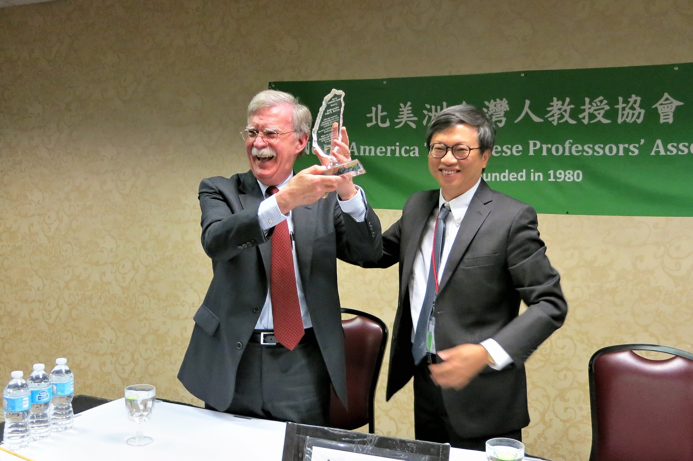
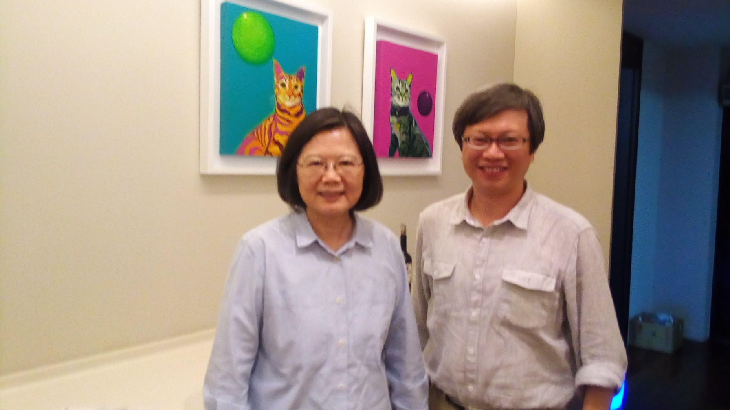
I’m empowered by the institute I represent to reach out to any level .
The President of Taiwan

Slide 6
Part 2
My Administrative Philosophy
A Director:
Must be a Visionary.
Must be a Leader.
Must foster Shared Governance.
Must serve as an Interface.
Must be a Collaborator and Facilitator.

Slide 7
1. A Director must be a Visionary
The first thing for a new director is to provide a clear vision with confidence.
A vision does not emerge from vacuum.
Align with the vision and mission of ISU (2018-2023) and CAST (2019-2024)
Will update SIT strategic plan (2020-2025) We will talk about this in Part 3.

Slide 8
2. A director must be a leader
Status quo cannot keep the program competitive
Be willing to lead and push for innovation
Keep looking for opportunities to move forward
Challenge the old model for better changes
Connect to every faculty on individual base to find out their needs; including understanding their research topics and teaching approach.
An academic director is not just a manager
Example is leadership
Researcher
Teacher
Manager (Service Management)

Slide 9
My Research and Stories behind
Type Two Complexity (Higher order asymptotic notation)
Cryptography (NPC)
ABC (Artificial Bee Colony) Algorithms
String manipulation (Security)
Teaching is the end product of research in higher education

Slide 10
3. Shared Governance
One of the most misunderstood concepts in higher education
Group vote
Asking faculty to do administrative chore
More committees
Shared responsibility
Not just
Plus
Broad and continuous communication among faculty and staff in the process of planning and decision-making on important issues.
Have institutionalized mechanism to safeguard the process.
No one can arbitrarily make decisions without advice of concerned constituents.
The role of every different concerned constituency should be well defined in the process.
Do not compromise accountability. The director, not the committee, who is ultimately held responsible for the consequence of the decision.

Slide 11
4. A director as an Interface
To Connect SIT, CAST, and ISU and beyond
SIT
Director
List<T>
[6]
List
Computer Science - General
Computer Science - Web Computing
Cybersecurity
Information Systems - Integration of Enterprise Systems
Information Systems - Systems Development/Analyst
Information Systems - Web Application Development
Integration of Enterprise Systems
Network and Telecommunications Management
SIT
G
int size();
T get(int i);
T set(int i, T item);
int indexOf(T item);
void add(T item);
void add(int i, T item);
T remove(int i);
Object[] toArray();
[1]
B
[5]
CAST
ISU
IlliniosUS
World
F
[3]
A
D
[0]
C
[4]
E
[2]
H
[7]

Slide 12
4. A director as an Interface
To Connect SIT, CAST, and ISU and beyond
Present the visions, missions, and goals of the School to a wide range of stakeholders and articulate the school's need in pursuit of these aims for resources.
Present ISU and CAST's missions and goals to the School and implement them through School's policy making and curriculum development.
Inform the School of the perspectives of the dean's decisions and actions that may affect the faculty and School.
Connect to each individual faculty and staff
5. A director as a collaborator and a facilitator
Part 3: Vision and Mission, Strategic Plan

Slide 13
Part 3:
Values
Learning and Scholarship
Diversity and Inclusion
Respect
Collaboration
Individualized Attention
Civic Engagement
Integrity

Slide 14
(summary)
Vision
(what we want to see)
Premier undergraduate and graduate programs.
Generates knowledge, HQ scholarship.
Broaden students’ perspectives.
Connect to the world.
Mission
(what we are doing to make our vision comes true )
We promote the highest academic standards in our teaching, scholarship, and public service.

Slide 15
2019-2024

Slide 16
CAST, we value:
Responsibility, honesty, trust, respect for all people, and integrity in all that we do.
Diversity, inclusion, and equity for students, faculty and staff.
Applied learning.
Individualized attention that includes recognition of each student as a significant contributor to our collective mission.
Advancement of knowledge including interdisciplinary, collaborative research.
Multidisciplinary traditions of our college.
Shared governance.
Civic engagement and outreach with our external constituents.
Sustainable practices in our programs and awareness in our students.
CAST’s Vision & Mission

Slide 17
CAST’s Strategic Plan (2019-2024)
28 strategies to achieve 4 Goals.
charges to administrators
So, how does SIT update its own strategic plan for 2020-2025 according to CAST’s?
What are the challenges and opportunities we have?
Let’s examine the landscape of current IT Enrollment

Slide 18
All data and charts in this presentation are taken from the following report:
Assessing and Responding to the Growth of Computer Science Undergraduate Enrollments
By The National Academy of Science, 2018
PDF: http://nap.edu/24926

Slide 19
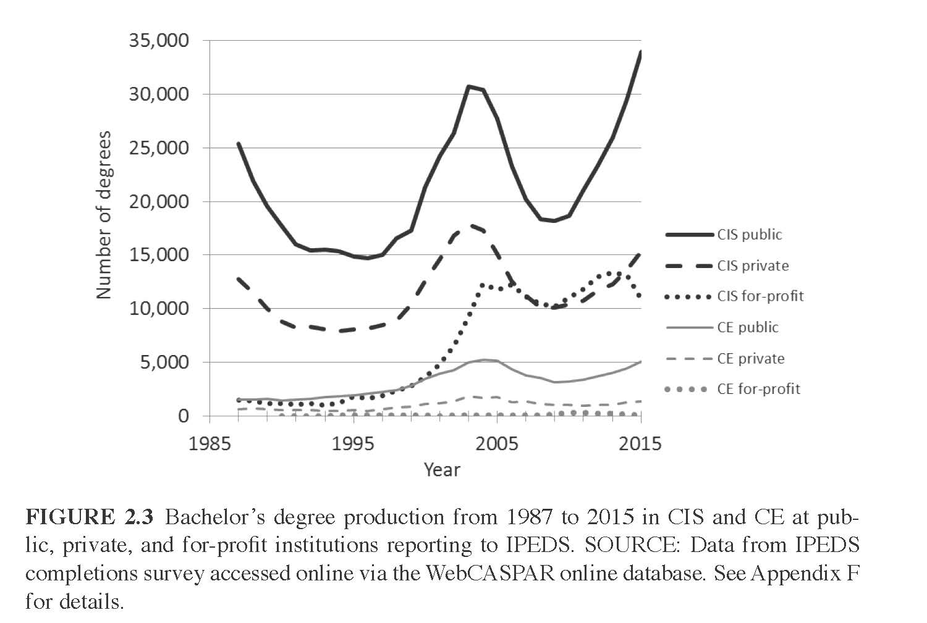
The Historic Trend of CIS degrees
degrees

Slide 20
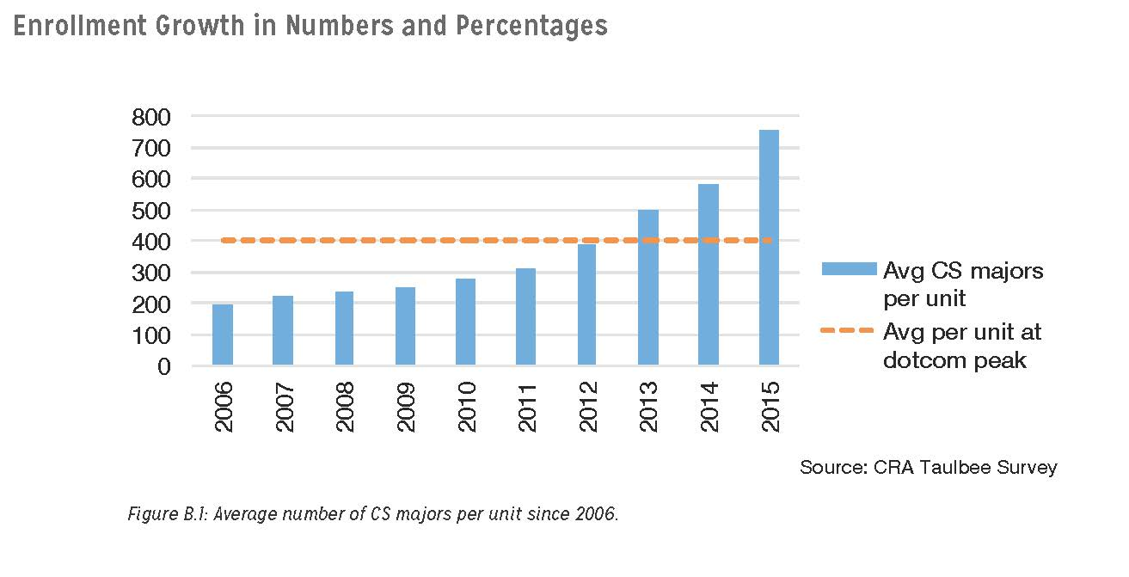
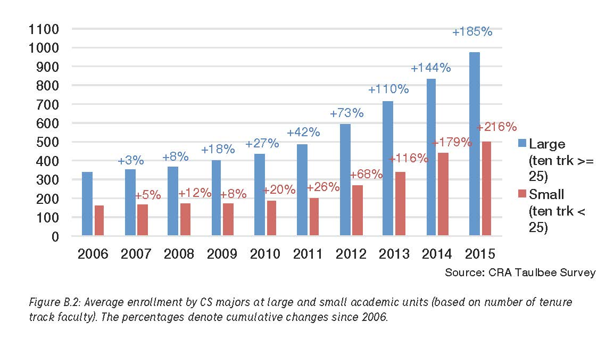
enrollments
SIT F: 18 U:755 G:55

Slide 21
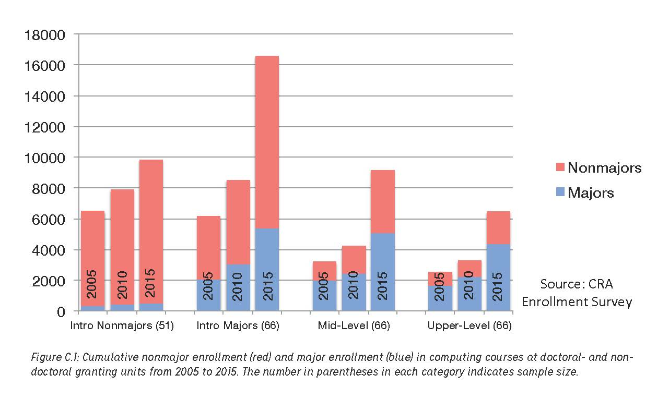
Non-majors Enrollment

Slide 22
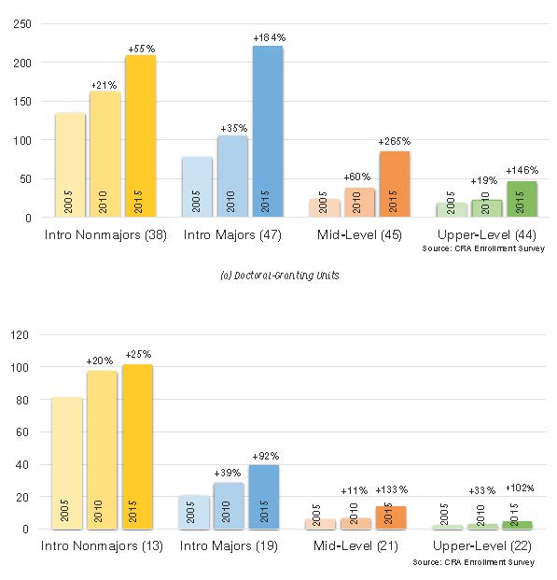
Non-majors Enrollment

Slide 23
With the CS/IT enrollment surge,
The academic leaders should take deliberate actions to address this trend with a sense of urgency beyond the School of IT.
Notes:
The line between CS and IS is no longer clear

Slide 24
Develop better strategies for faculty hiring and retention.
Re-evaluate and enhance the role of teaching faculty.
Be aware of the diversity issue.
NSF can be a very helpful resource, especially for undergraduate computing/information education
Develop new partnership with computing industry and ask them to support education for future workforce. (E.g. State Farm, High Order Function)
Ask state/government to provide sufficient support as computing is no longer a single discipline but a supporting technology for every discipline.
Director should:

Slide 25
Inter-Disciplinary Research (IDR)
5 out of 9 CAST’s core values through IDR
Diversity
Applied learning
Advancement of knowledge
Multidisciplinary
External constituents
OK, 8 out of 9
Integrity
Individualized attention
Sustainable practices

Slide 26
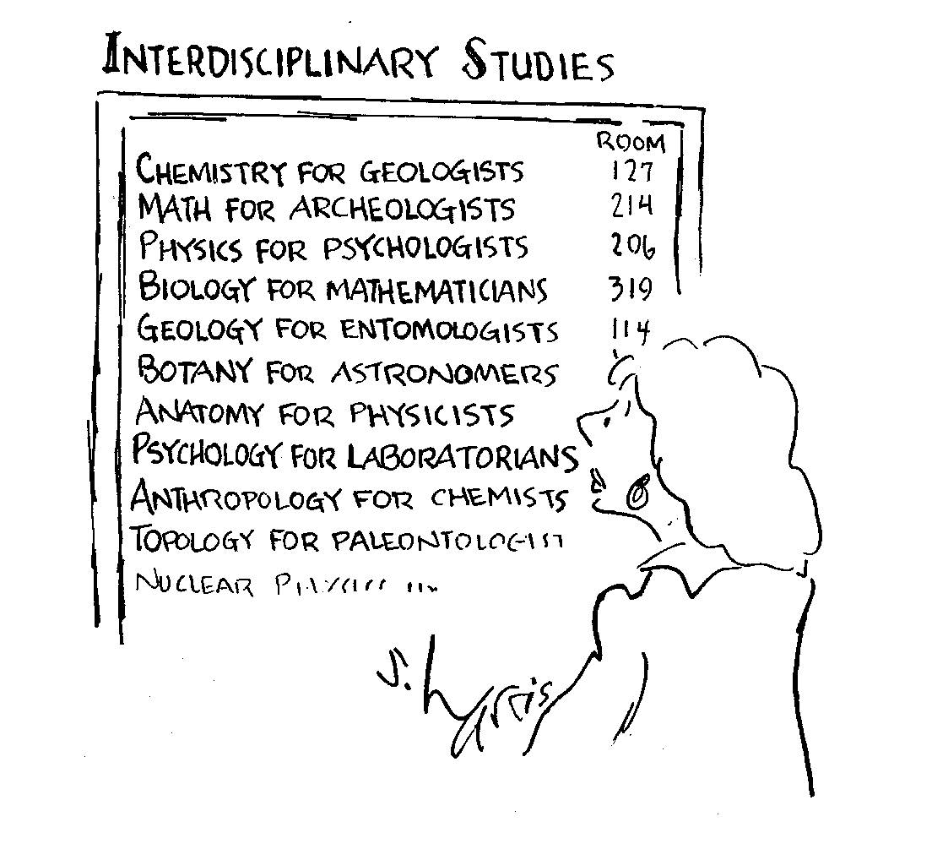
CAST
Agriculture
Criminal Justice
Family & Consumer Sciences
Health Sciences
Information Technology
Kinesiology & Recreation
Military Science
Technology
Cyber Security for Agriculture OU 213E
Big Data for Criminal Justice OU 213D
Animation for K&R STV 104
Data Structures for Health Sciences STV 105
AI for Mechanical Engineering STV 105

Slide 27
Agriculture
Criminal Justice
Family & Consumer Sciences
Health Sciences
Information Technology
Kinesiology & Recreation
Military Science
Technology
This is happening elsewhere
UIUC BS in CS & CS
Computer Science & Crop Sciences
CS Core: 22 hrs
CS topics: 9-11 hrs
Crop Science Core: 34-36 hrs

Slide 28
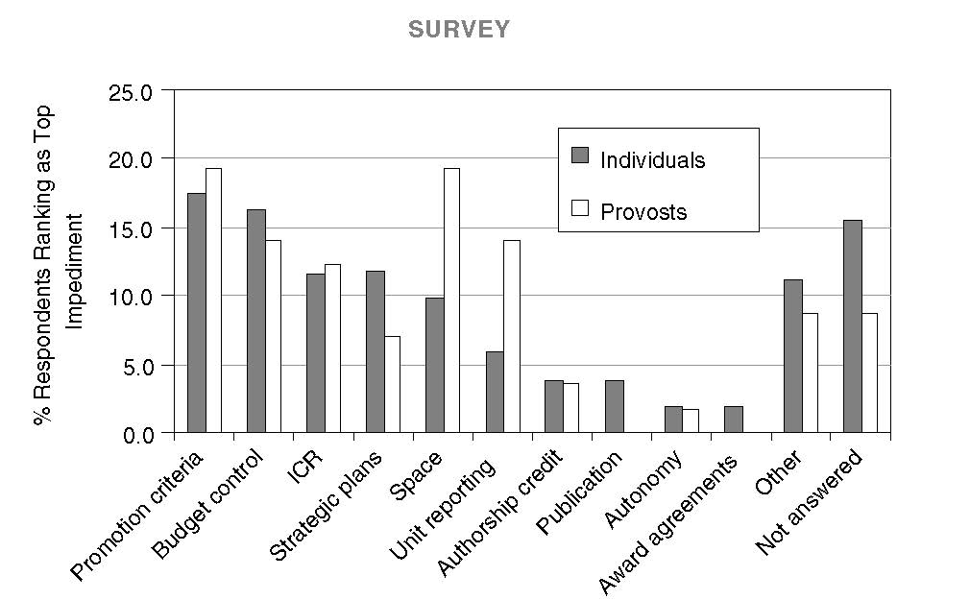
IDR will not happen without challenges from within:
Students turn out to be the least problem hinders IDR
“Students are the integrating glue”
– Harvey Cohen, Chair of Interdisciplinary Initiative Program, Stanford University
Top impediments to IDR

Slide 29
Thank You!!
Q & A

